Slide 1
Adidas Sales Project

Slide 2
Agenda
03
02
01
Exploratory Data Analysis (EDA)
Read Data - Understand Data
Data Collection

Slide 3
01
Data Collection

Slide 4


Data Collection
Kaggle – Google Dataset
https://www.kaggle.com/datasets/bcnishantreddy/adidas-us-sales-datasets
https://www.kaggle.com/datasets/vishwas199728/adidas-sales-data

Slide 5
02
Read Data

Slide 6
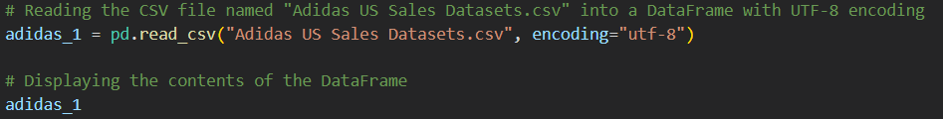
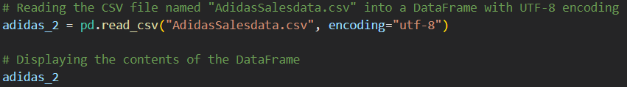
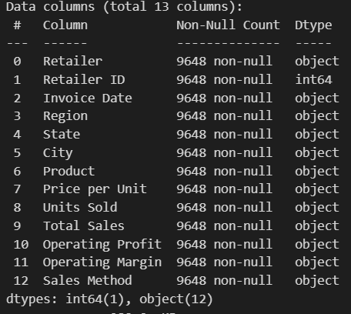
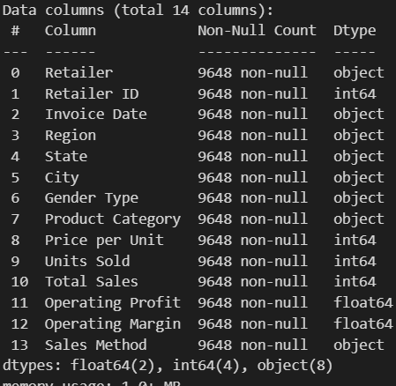
Read Data
CSV_1
CSV_2

Slide 7
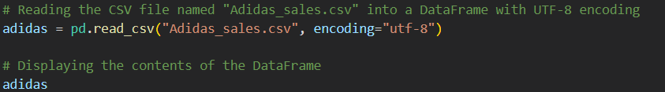
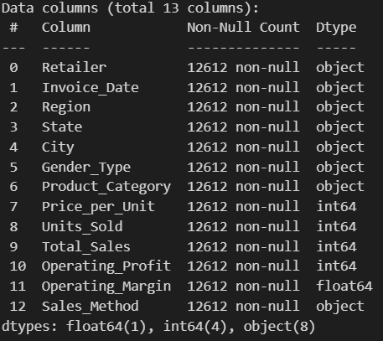
Understand Data
CSV_3
1. Retailer : The name of the retailer selling the products.
2. Invoice_Date : The date when the invoice was generated, formatted as month-year.
3. Region : The geographic region where the sale took place.
4. State : The state within the region where the sale occurred.
5. City : The city within the state where the sale occurred.
6. Gender_Type : The gender category targeted by the product (Men, Women).
7. Product_Category : The category of the product sold (Apparel, Street Footwear, Athletic Footwear).
8. Price_per_Unit : The price of a single unit of the product sold.
9. Units_Sold : The number of units of the product sold in the transaction.
10. Total_Sales : The total sales amount for the transaction.
11. Operating_Profit : The profit earned from the sale after deducting operating expenses.
12. Operating_Margin : The ratio of operating profit to total sales, expressed as a percentage.
13. Sales_Method : The method used to make the sale (Outlet, Online, In-store).

Slide 8
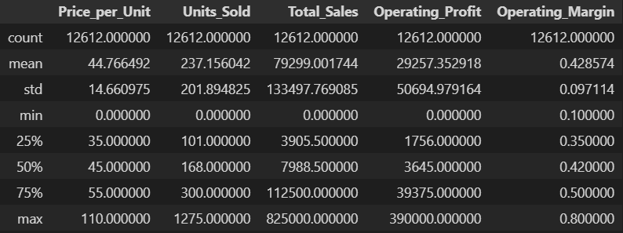
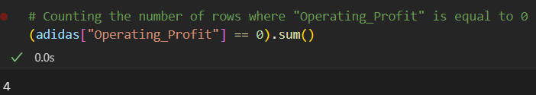
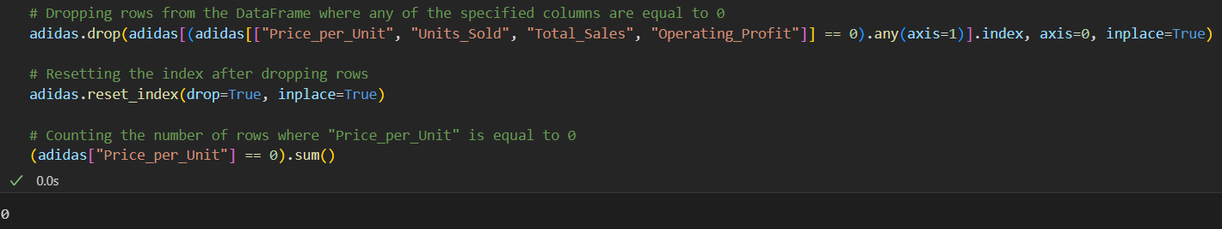
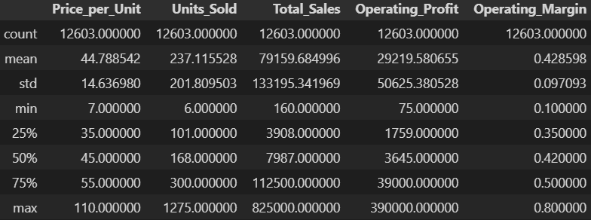
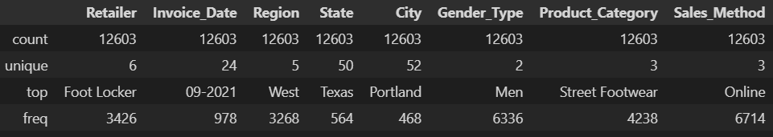

Slide 9
03
Exploratory Data Analysis (EDA)

Slide 10
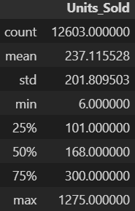
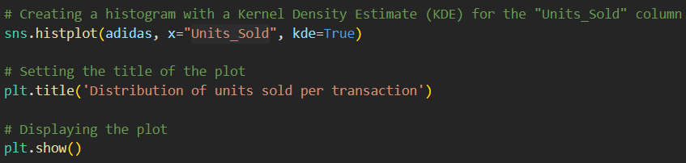
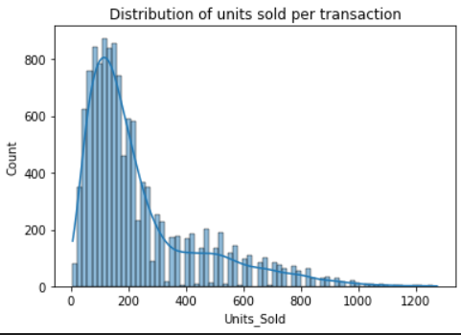
1
What is the distribution of units sold per transaction?

Slide 11
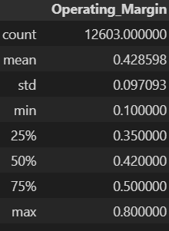
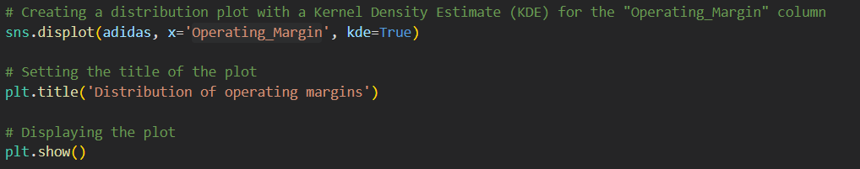
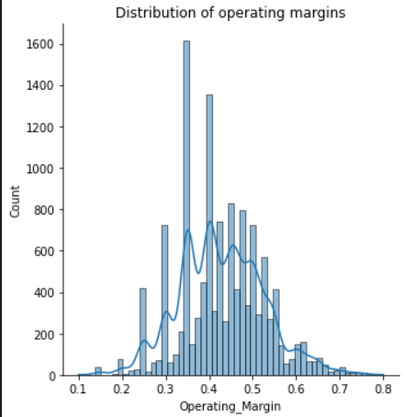
2
What is the distribution of operating margins?

Slide 12
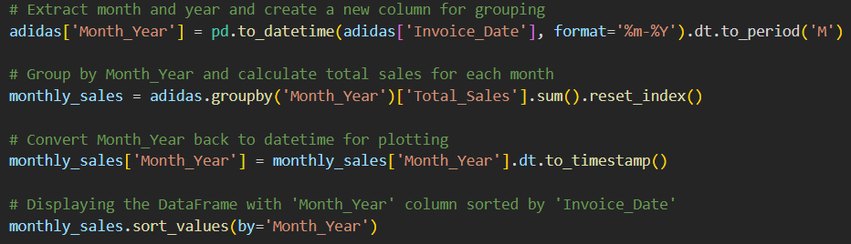
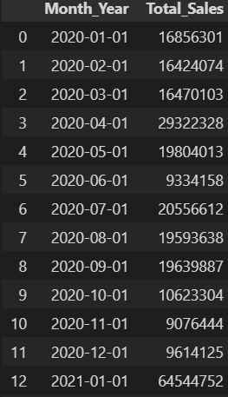
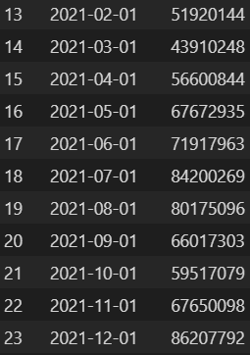
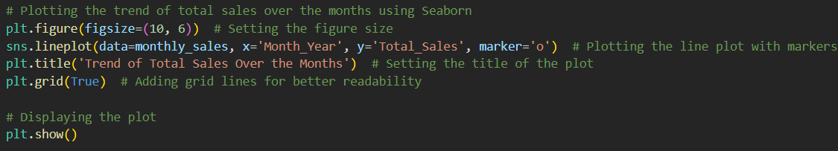
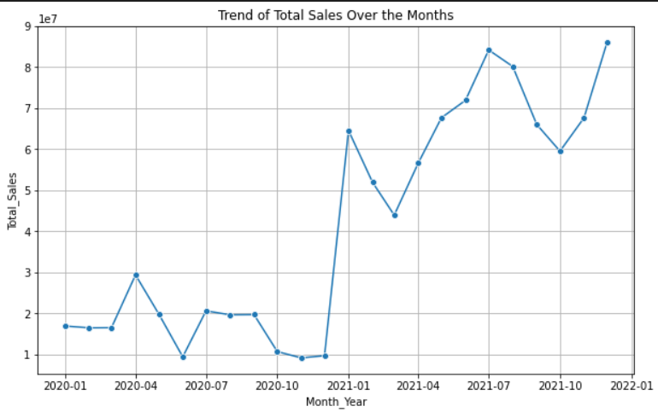
3
What is the trend of total sales over the months?

Slide 13
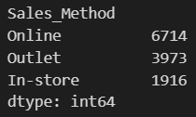
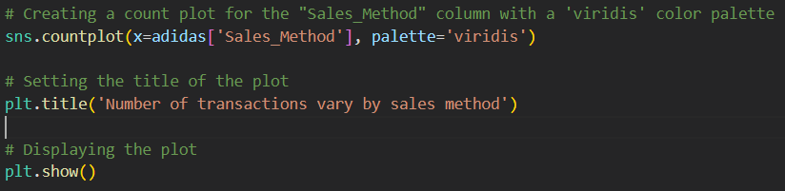
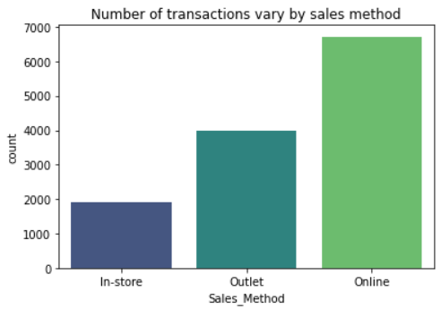
4
How does the number of transactions vary by sales method?

Slide 14
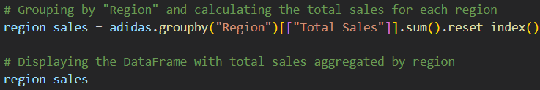
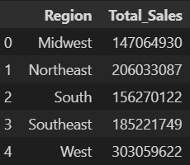
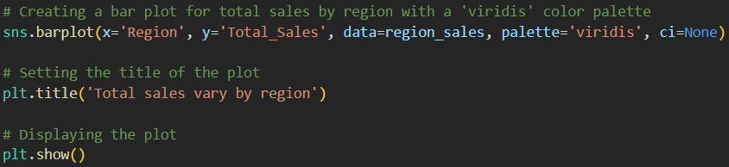
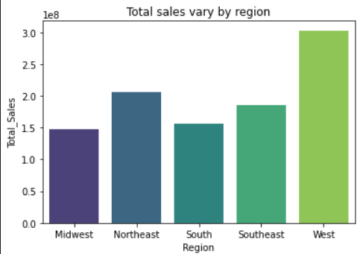
5
How does total sales vary by region?

Slide 15
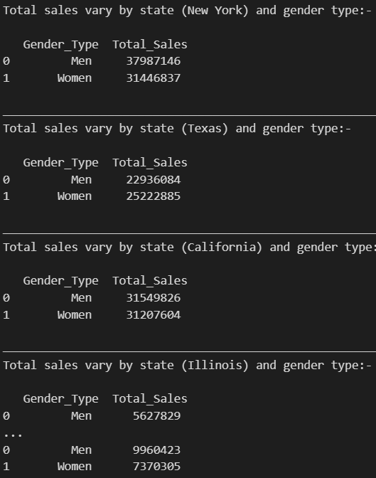
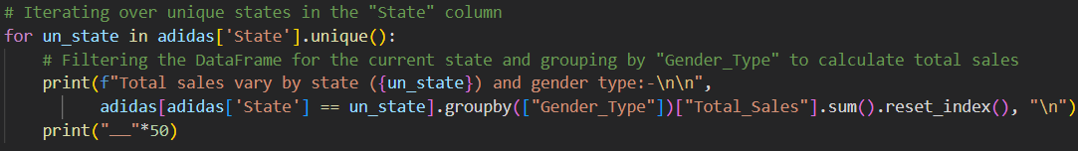
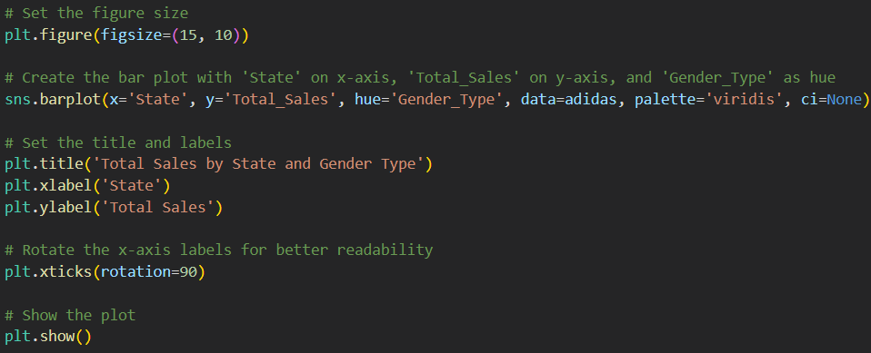
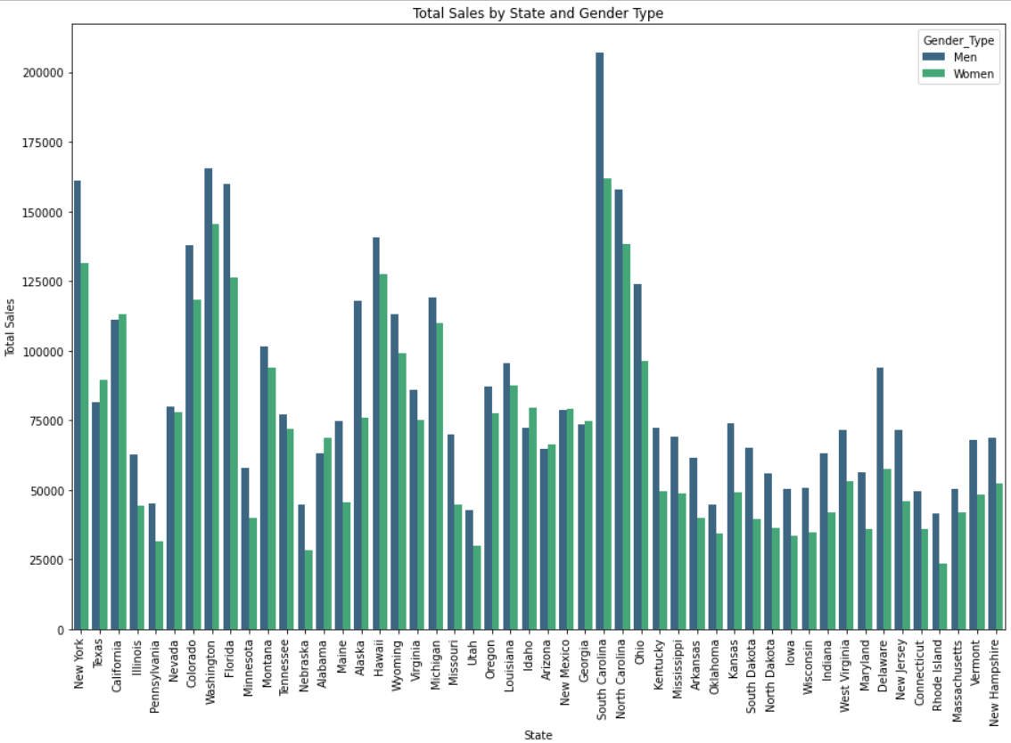
6
How do total sales vary by state and gender type?

Slide 16
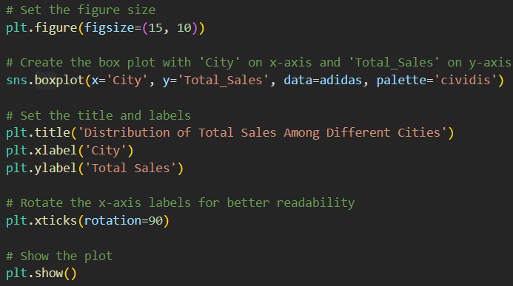
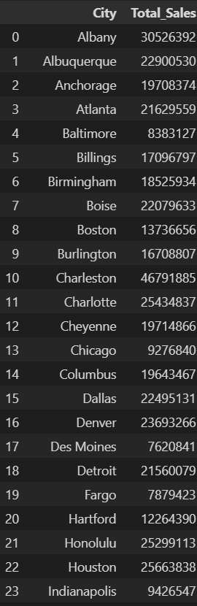
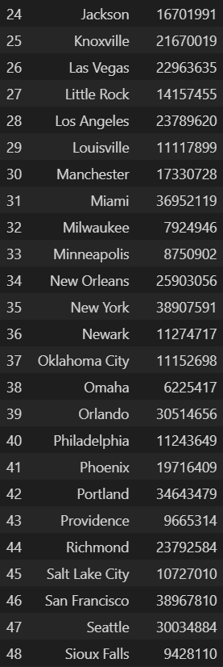
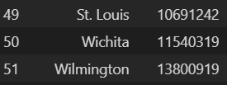
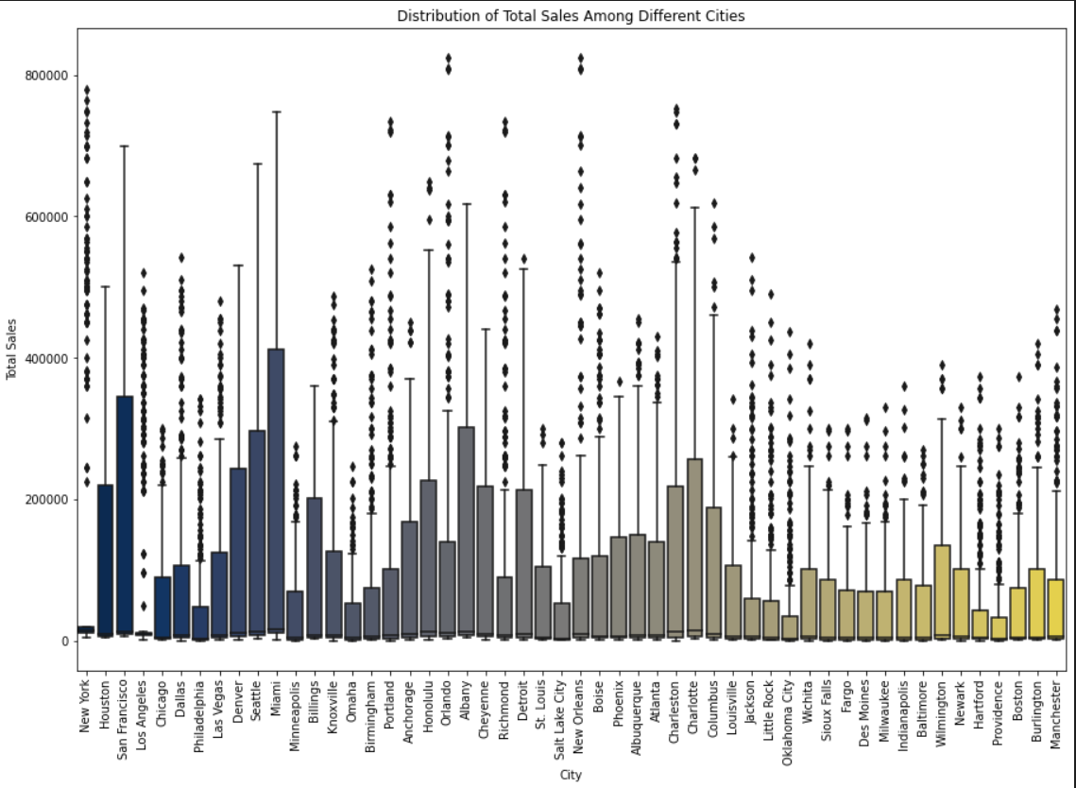
7
What is the distribution of total sales among different cities?

Slide 17
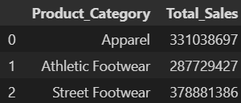
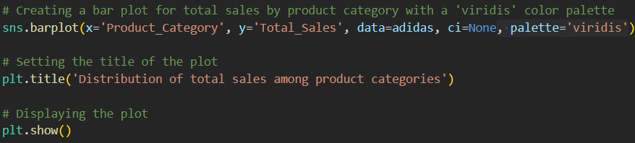
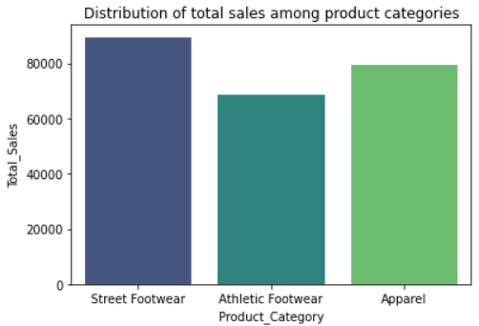
8
What is the distribution of total sales among product categories?

Slide 18
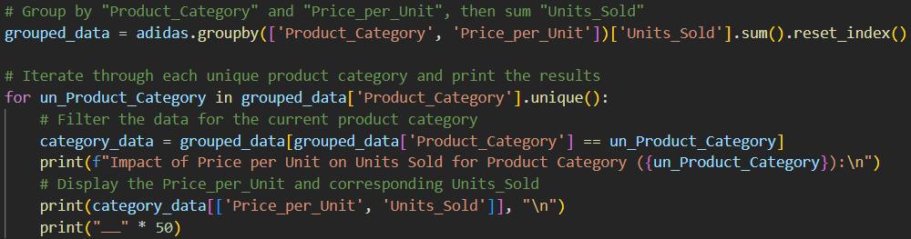
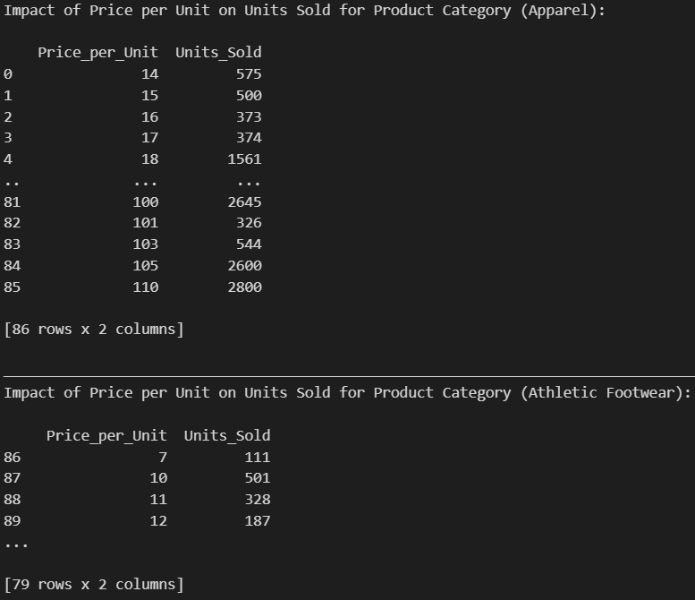
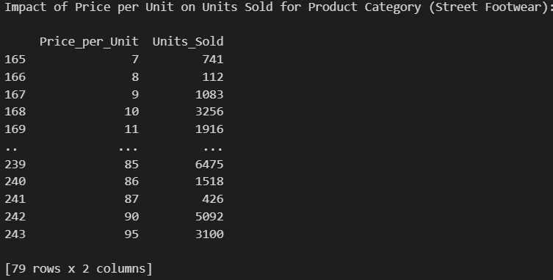
9
How does the price per unit impact units sold for different product categories?

Slide 19
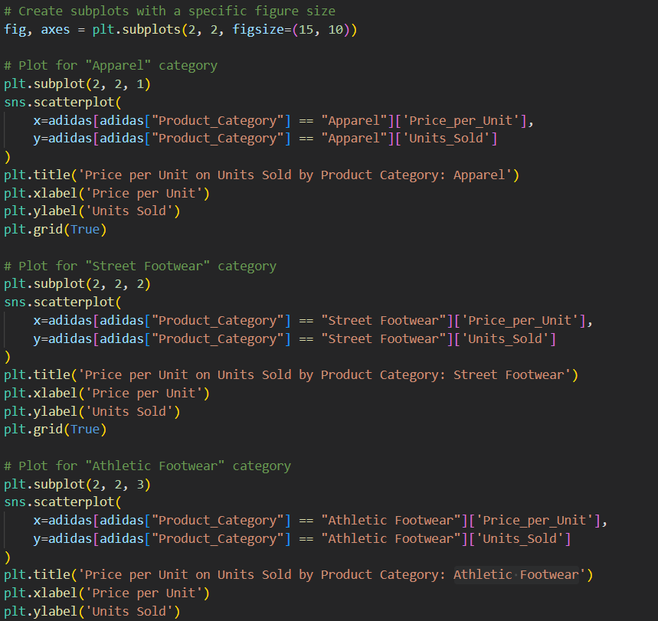
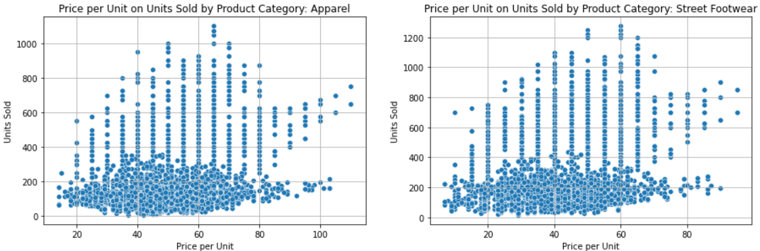
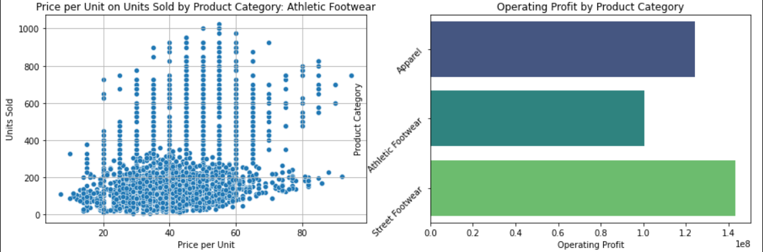
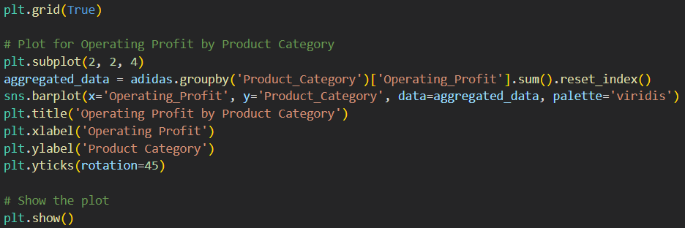

Slide 20
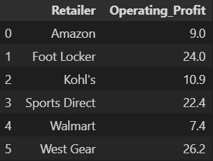
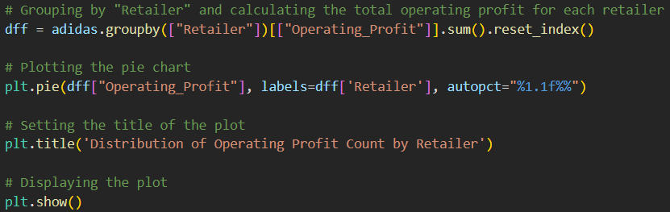

10
How does the distribution of operating profit vary among different retailers?

Slide 21

Thanks
https://github.com/MinaTharwat93/Adidas-Sales---EDA.git
https://www.linkedin.com/in/mina-tharwat-aa5a6323a
+20 127 303 1615

